Slide 1
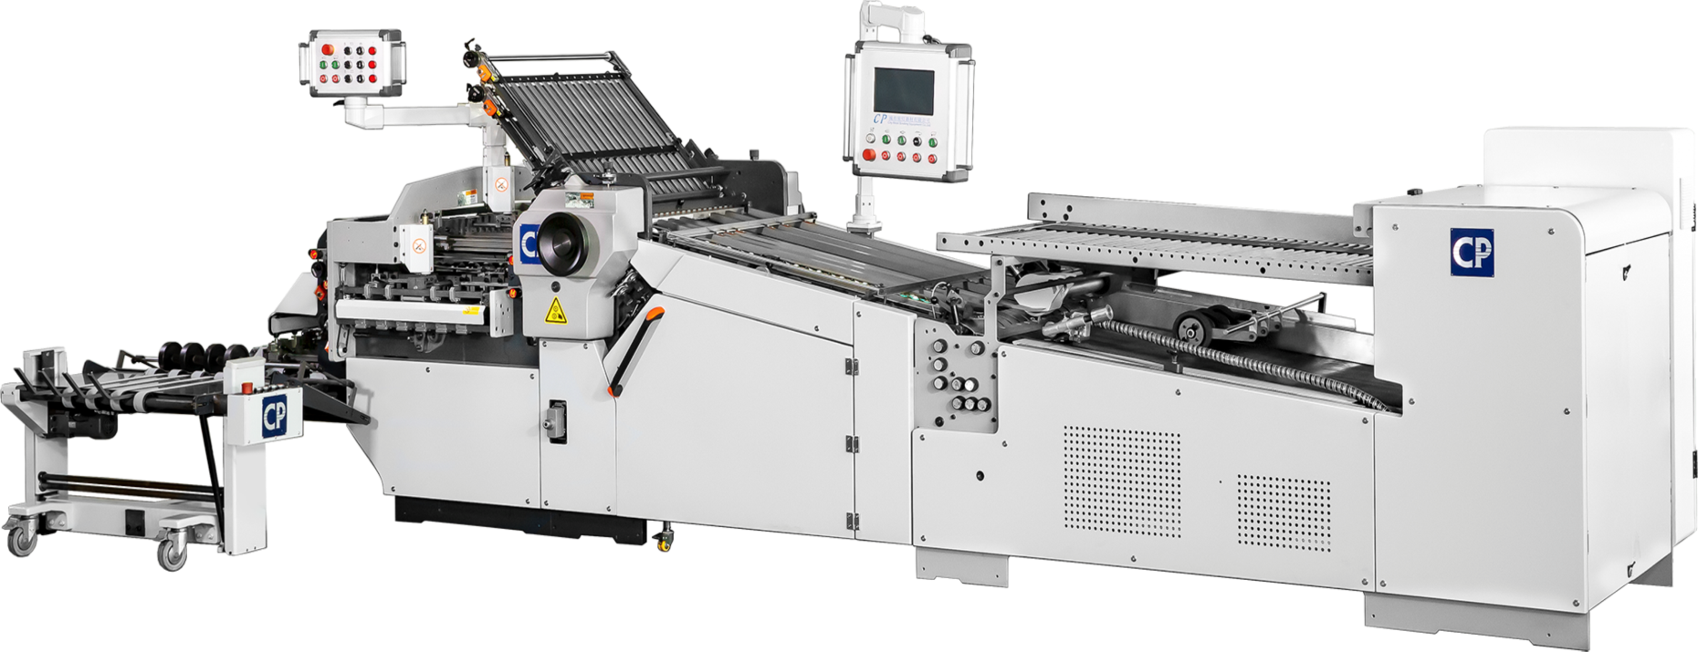

Slide 2



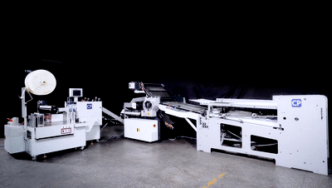
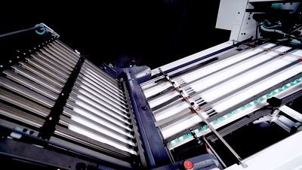
HXCP offer high-performance folders for all your folding needs, our tried and tested CP folding machines offer all the benefits you would expect:
User Friendly
High reliability
Stable productivity
Dependable folding quality
Low maintenance cost
High value preservation rate

Slide 3

Legendary and Classic CP Folding Machine
CP industrial folder, since it was put on the market in 2000,with continuous technical improvements and innovations, nowadays,it has become the most popular folding machine in China, won the reputation of "easy operation, stable and durable, high speed and high efficiency". A variety of optional extension and accessories are available for your selection.

Slide 4
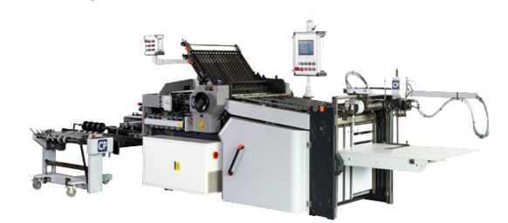
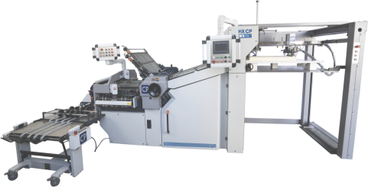
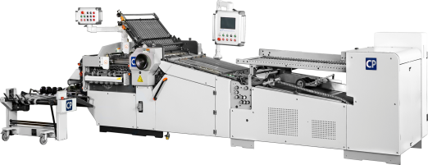
3 Optional Feeder System
for different requirement
Flat Pile Feeder
Round Pile Feeder
Pallet Pile Feeder
1.3m
A stack of 1000 sheets of paper is 11.8 cm high.

Slide 5

Main Features
Electric Knives
more accurate durable
Patent fine & straight grain steel roller
also suitable for thin paper
Electroplated Buckles
scratch-proof
Intelligent PLC Control System
Imported Well-renowned Brand Electrical Components
professional engineer
High precision calibration
continuous technology innovate

Slide 6
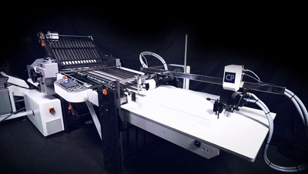

Flat Pile Feeder
3 hole PU suction wheel
No worries even with thin paper and static electricity
Flat Pile Feeder System

Slide 7
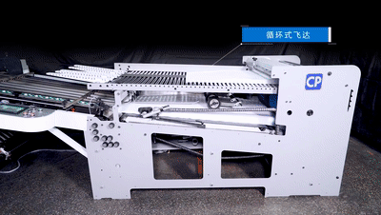

Round Pile Feeder
continuous feeding paper, higher productivity
Round Pile Feeder System

Slide 8
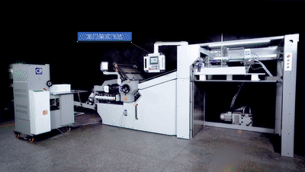

Pallet Pile Feeder
rolls the entire skid full of paper in with a pallet jack, save time and labor,more convenience,higher efficiency
Pallet Pile Feeder System
Verticl pressing stacker

Slide 9
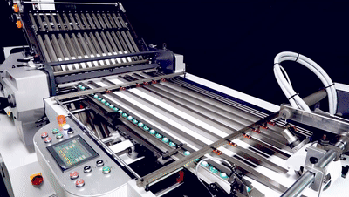
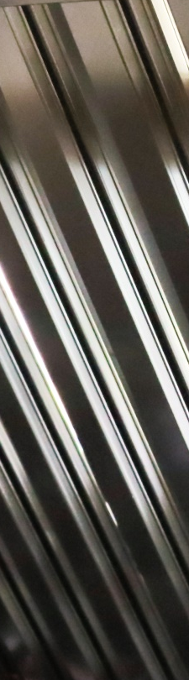

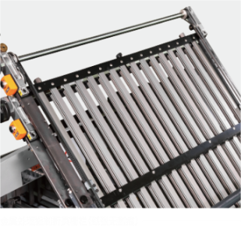
Electroplated buckles & deflector
scratch-proof,
capable of folding surface-sensitive pages
scratch-proof buckle plate detail

Slide 10
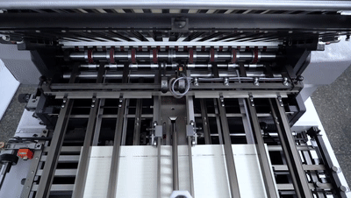
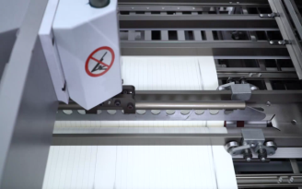

Electronic Knife
Different from the pneumatic knife controlled by the solenoid valve, which has higher requirements on the air pressure, and the stream in the gas will cause damage the solenoid valve in long time use.
Electric knife with imported servo motor system, which is more precise, more efficient and more durable.

Slide 11
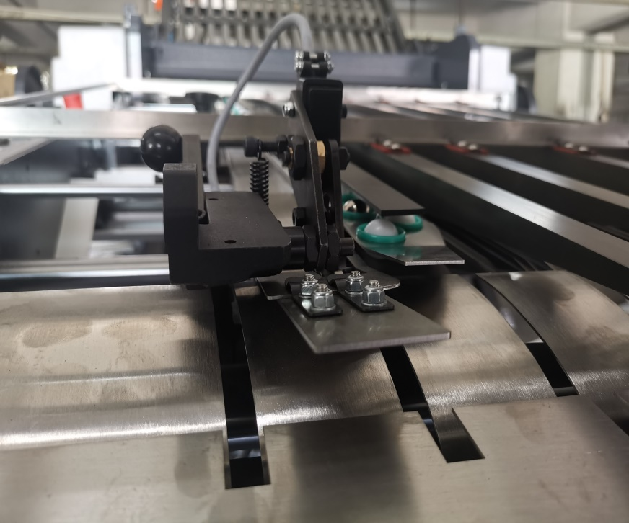

Sheet Detector System
double sheet, paper jam,blind-sheet diagnostic,
features mechanical touch switch, which makes the emergency stop more stable and precise

Slide 12
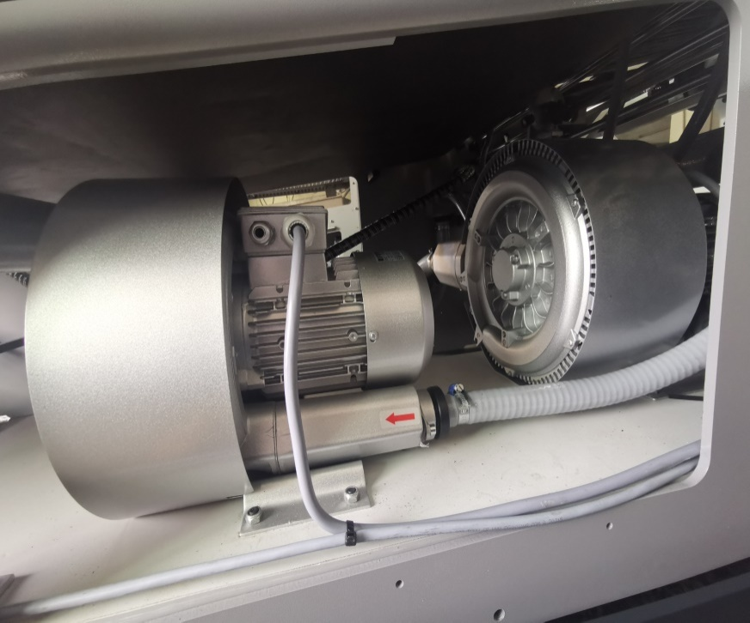

low noise air pump
Imported from German, deduct noise effiently

Slide 13
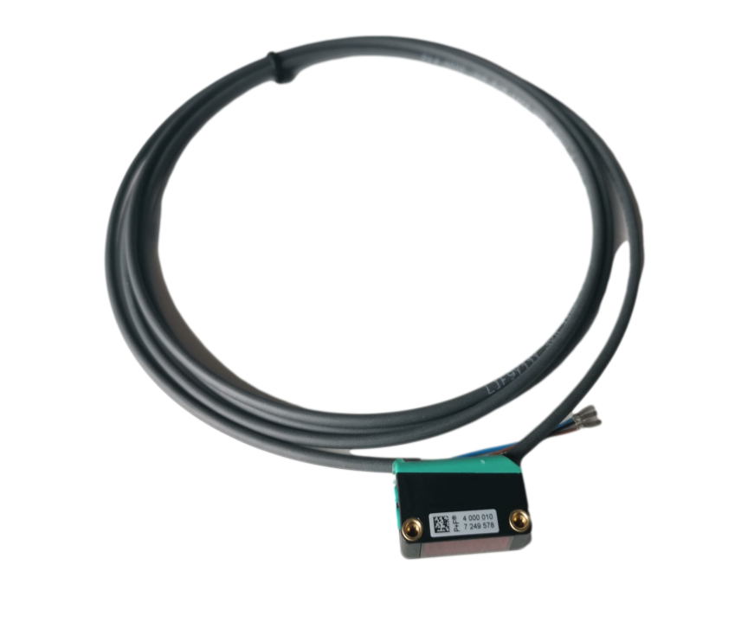
Advanced Electronic Sensor
It can effectively monitor color pages, dark ink and other printed materials
from Germany

Slide 14
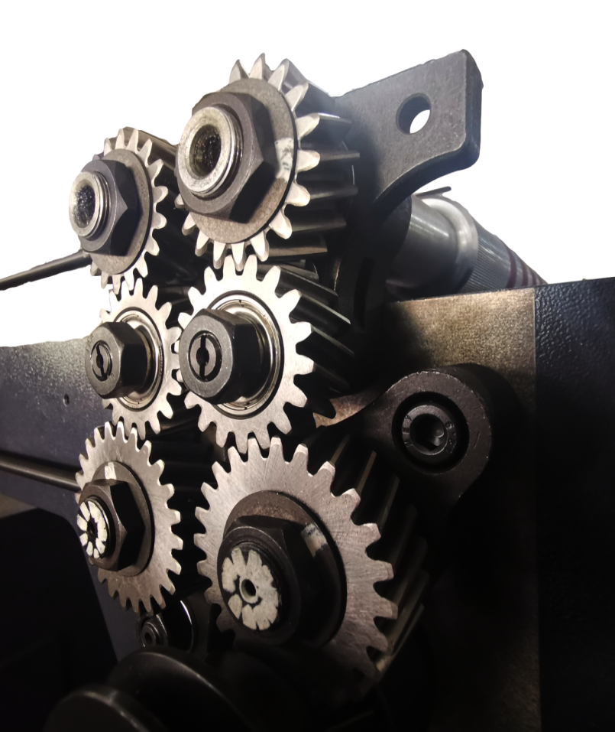

Germany Special helical Gears
deduct wear and tear

Slide 15
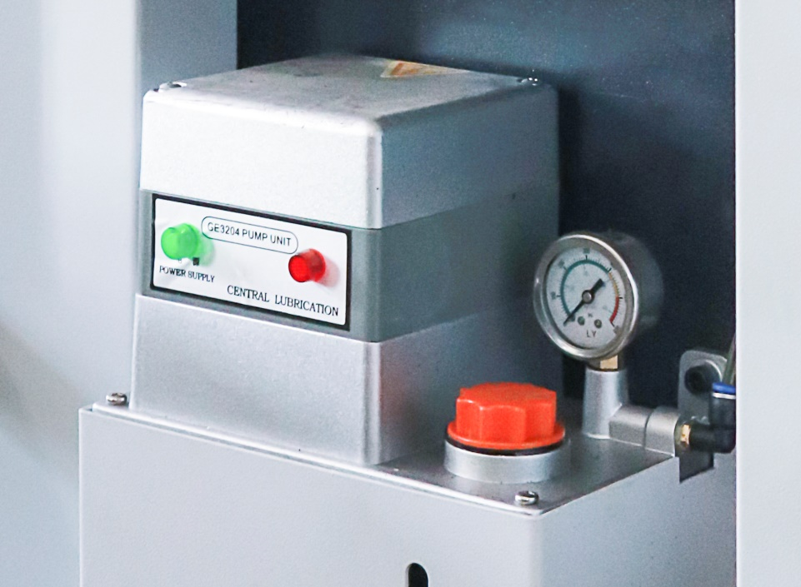

Automatic Lubrication Device
automatic monitor machine running status, automatic refill lubrication oil if needed,low maintenance is required, support the smooth operation of the folding machine.

Slide 16
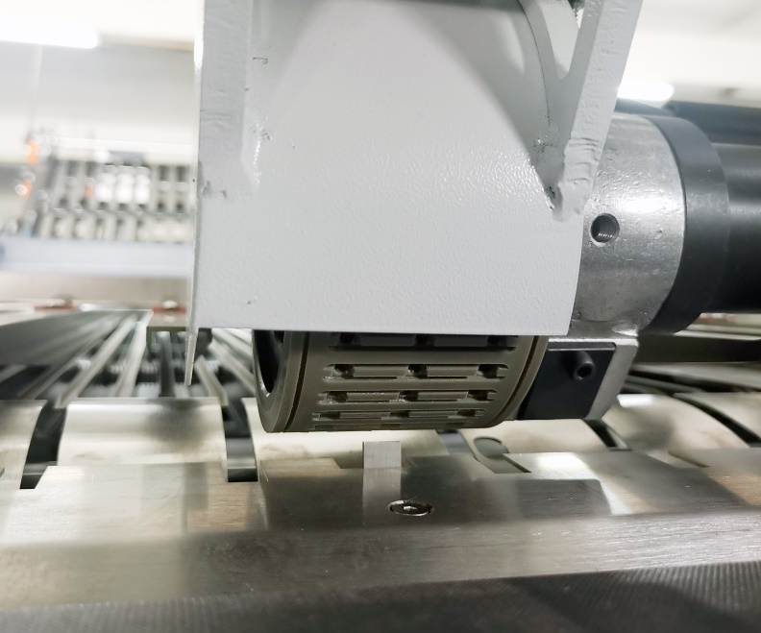
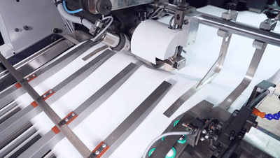

3 hole PU suction wheel
easier to suck and separate paper
more stable and smooth
also capable of handling thin paper

Slide 17


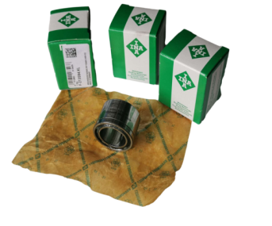
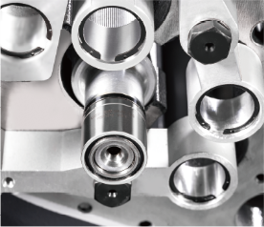
Germany ball bearing
INA ball gearing,made in Germany,more stable and durable

Slide 18
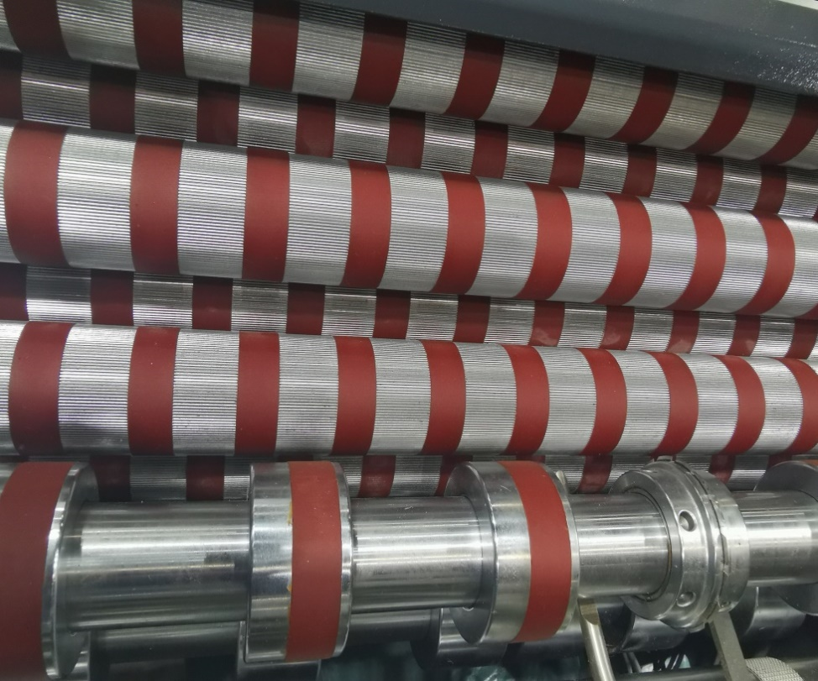
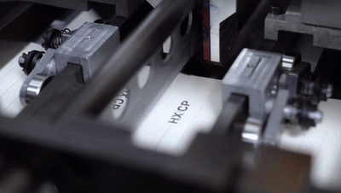
Special Steel rollers
Soft polyurethane section provides superior traction, holds excellent register, prevents marking；
patent fine & straight grain;
also capable of handling thin paper fold

Slide 19
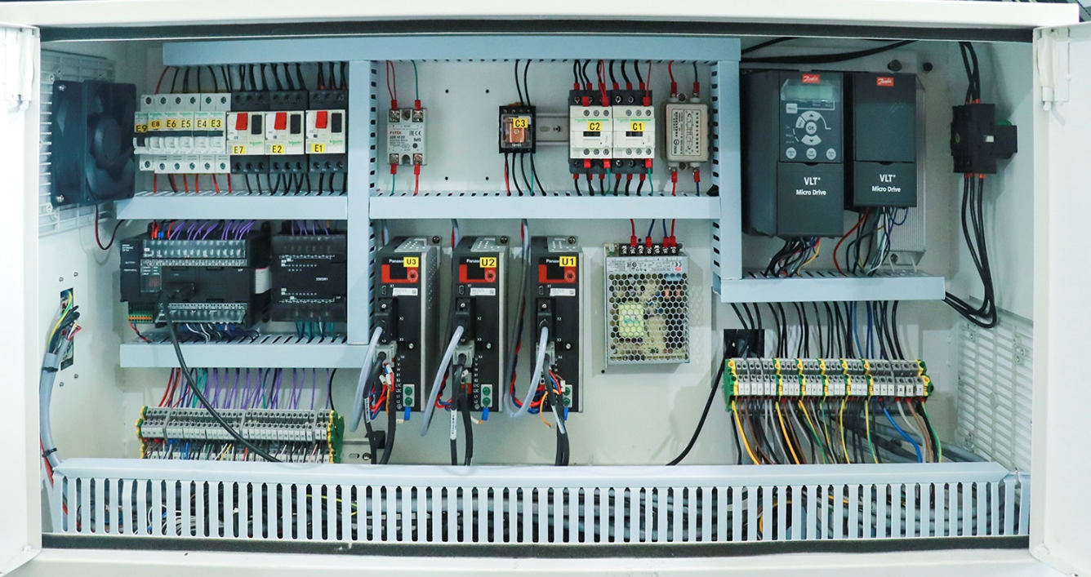

electrical box
select world-renowned brand of electrical components
clear and rigorous layout of electrical box
Guarantee of stable and durable operation

Slide 20




Worldwide Well-Renowned Components
Ball bearing | Germany INA
polyurethane section | Germany Formula
Special helical gears | AVIC
Electric | Schneider
PLC/Converter | Schneider
conveyor belt | Seamless and anti-static belt imported from Germany

Slide 21
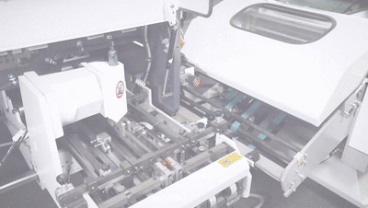
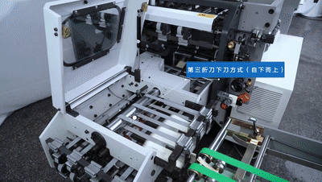
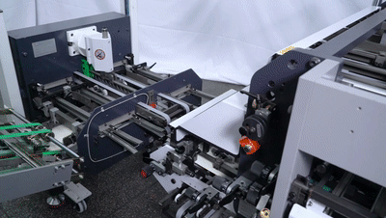
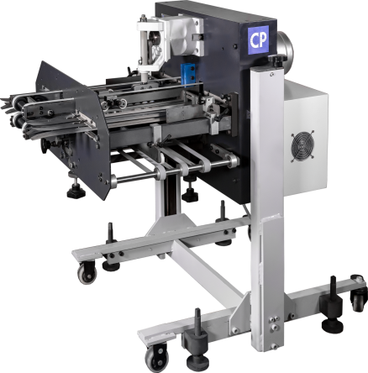
downward knife
upward knife
downward/upward knife in one
item | paramter
max. sheet size | 540×330mm
min.sheet size | 145×100mm
power | 2.0kW
dimension | 1.2×0.8×1.0m
weight | 400kG
the third knife
32P fold in one go

Slide 22
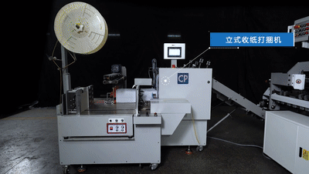
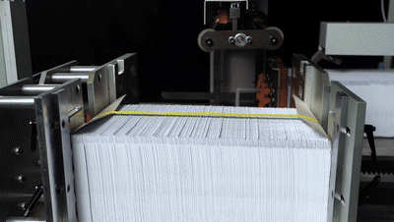
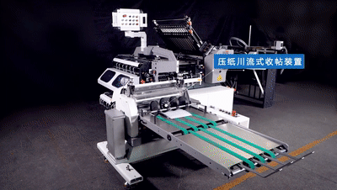
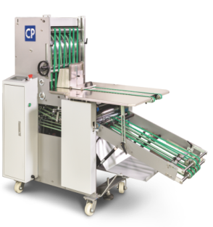
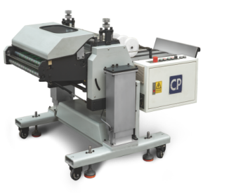
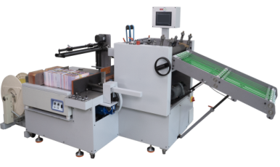
Stacker
3 optionals
Vertical pressing Stacker with auto packing station
Vertical Pressing Stacker
Horizontal stream pressing Stacker
efficiency
flexibility

Slide 23
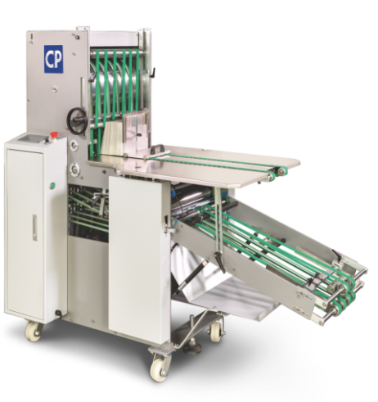

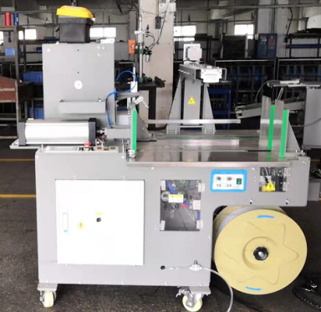
Stacker
3 optionals
Vertical Pressing Stacker with Bundler
Vertical Pressing Stacker
horizontal pressing Stacker
item | paramter
max. sheet size | 285×210mm
min. sheet size | 210×136mm
power | 2.5kW
dimension | 2.7×1.5×1.7m
weight | 500kG
pressure | 3000N
item | paramter
max. sheet size | 400×310mm
min. sheet size | 135×85mm
power | 0.95kW
dimension | 1.66×0.9×1.45m
weight | 500kG
item | paramter
max. sheet size | 500×475mm
min. sheet size | 120×110mm
power | 2.3kW
dimension | 1.7×1.0×1.0m
weight | 400kG

Slide 24
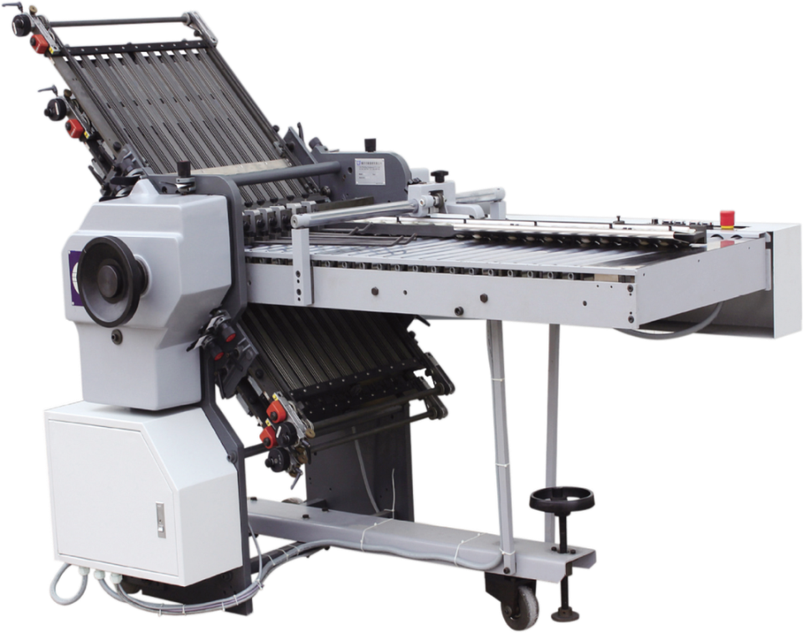
second unit - 4 buckles folding
optional extensions for wide folding range
item | parameter
max. sheet siz | 520×1075mm
min. sheet siz | 50×120mm
power | 2.5kW
dimension | 1.7×1.0×1.0m
weight | 500kG

Slide 25
more optional extensions
meet your different requirements
HHS gluing device
T-buckle
sheet detection
noisehoods

Slide 26

CP Round Pile Folding Machine
PARAMETER of MACHINE
item |  | CP66/4KL-R | CP78/4KLL-R | CP80/4KLL-R
Technology Parameter | max.sheet paper | 660×1040mm | 780×1140mm | 800×1200mm
 | min.sheet paper | 180×100mm | 200×150mm
 | Sheet Gram Range | 40-210gsm
 | Max.speed | 210m/min
Machine Parameter | Power | 7kW
 | Dimension | 6.4×2.8m
 | Weight | 2000kG

Slide 27
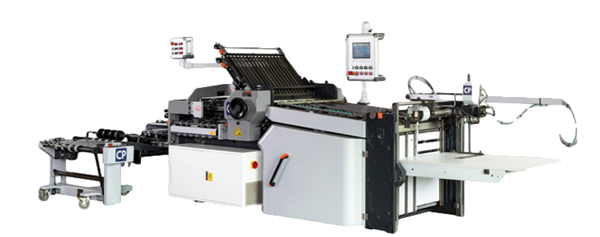
CP Flat Pile Folding Machine
PARAMETER of MACHINE
item |  | CP66/4KL | CP78/4KLL | CP80/4KLL
Technology Parameter | max.sheet paper | 660×1040mm | 780×1140mm | 800×1200mm
 | min.sheet paper | 180×100mm | 200×150mm
 | Sheet Gram Range | 40-210gsm
 | Max.speed | 210m/min
Machine Parameter | Power | 7kW
 | Dimension | 5.4×2.8m
 | Weight | 1800kG

Slide 28

PARAMETER of MACHINE
CP Pallet Pile Folding Machine
item |  | CP66/4KL-F | CP78/4KLL-F | CP80/4KLL-F
Technology Parameter | max.sheet paper | 660×1040mm | 780×1140mm | 800×1200mm
 | min.sheet paper | 200×150mm
 | Sheet Gram Range | 40-210gsm
 | Max.speed | 210m/min
Machine Parameter | Power | 8.5kW
 | Dimension | 4.8×1.51m | 4.8×1.63m | 4.8×1.65m
 | Weight | 2200kG | 2300kG | 2400kG
 | Height range of stack | 0-1200mm

Slide 29

Powerful and High Effective CP Folding Machine
CP folding machine, Easy to use, durable and efficient, liked and recommended by the operator, printing factory owner and other clients, it’s our CP folding machine.
In addition to standard units,more optinal units like:feeder, stacker, etc are provided to meet your different requirements.

